Slide 1

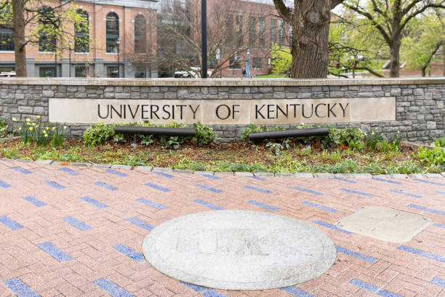
RFP UK-2541-26
Maintenance, Repair and Operations (MRO) &
Trade Services
Training Session
Location: Zoom
Date: August 20, 2025
Contracting Officer: Ken Scott
Economic Engagement Manager: Marilyn Clark
*If you are currently on MRO Contract UK-2368-24, you need not submit to this proposal.

Slide 2
Agenda
Introductions – Ken Scott
Economic Engagement – Marilyn Clark
What is MRO?
Questions??
How to Complete the Request for Proposal – Ken Scott
Authorization of Work
Key Event Dates

Slide 3
University of Kentucky Economic Engagement
Marilyn Clark, Economic
Engagement Manager
Marilyn.Clark@uky.edu

Slide 4
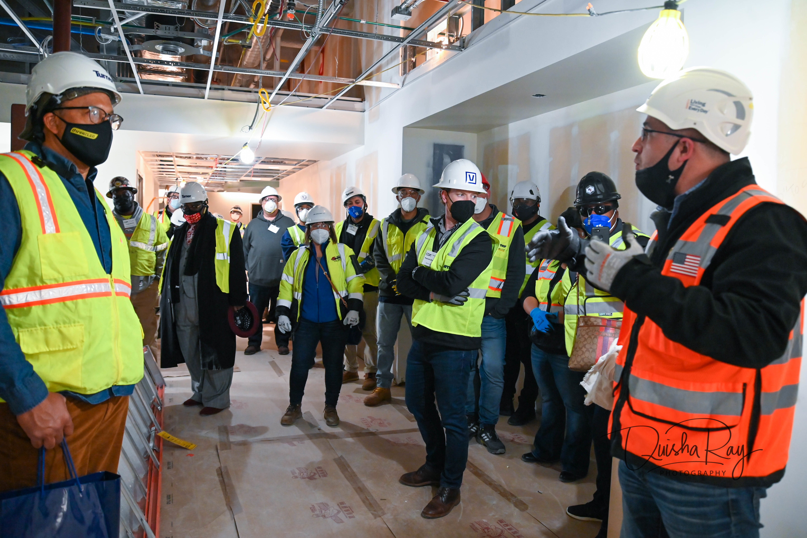

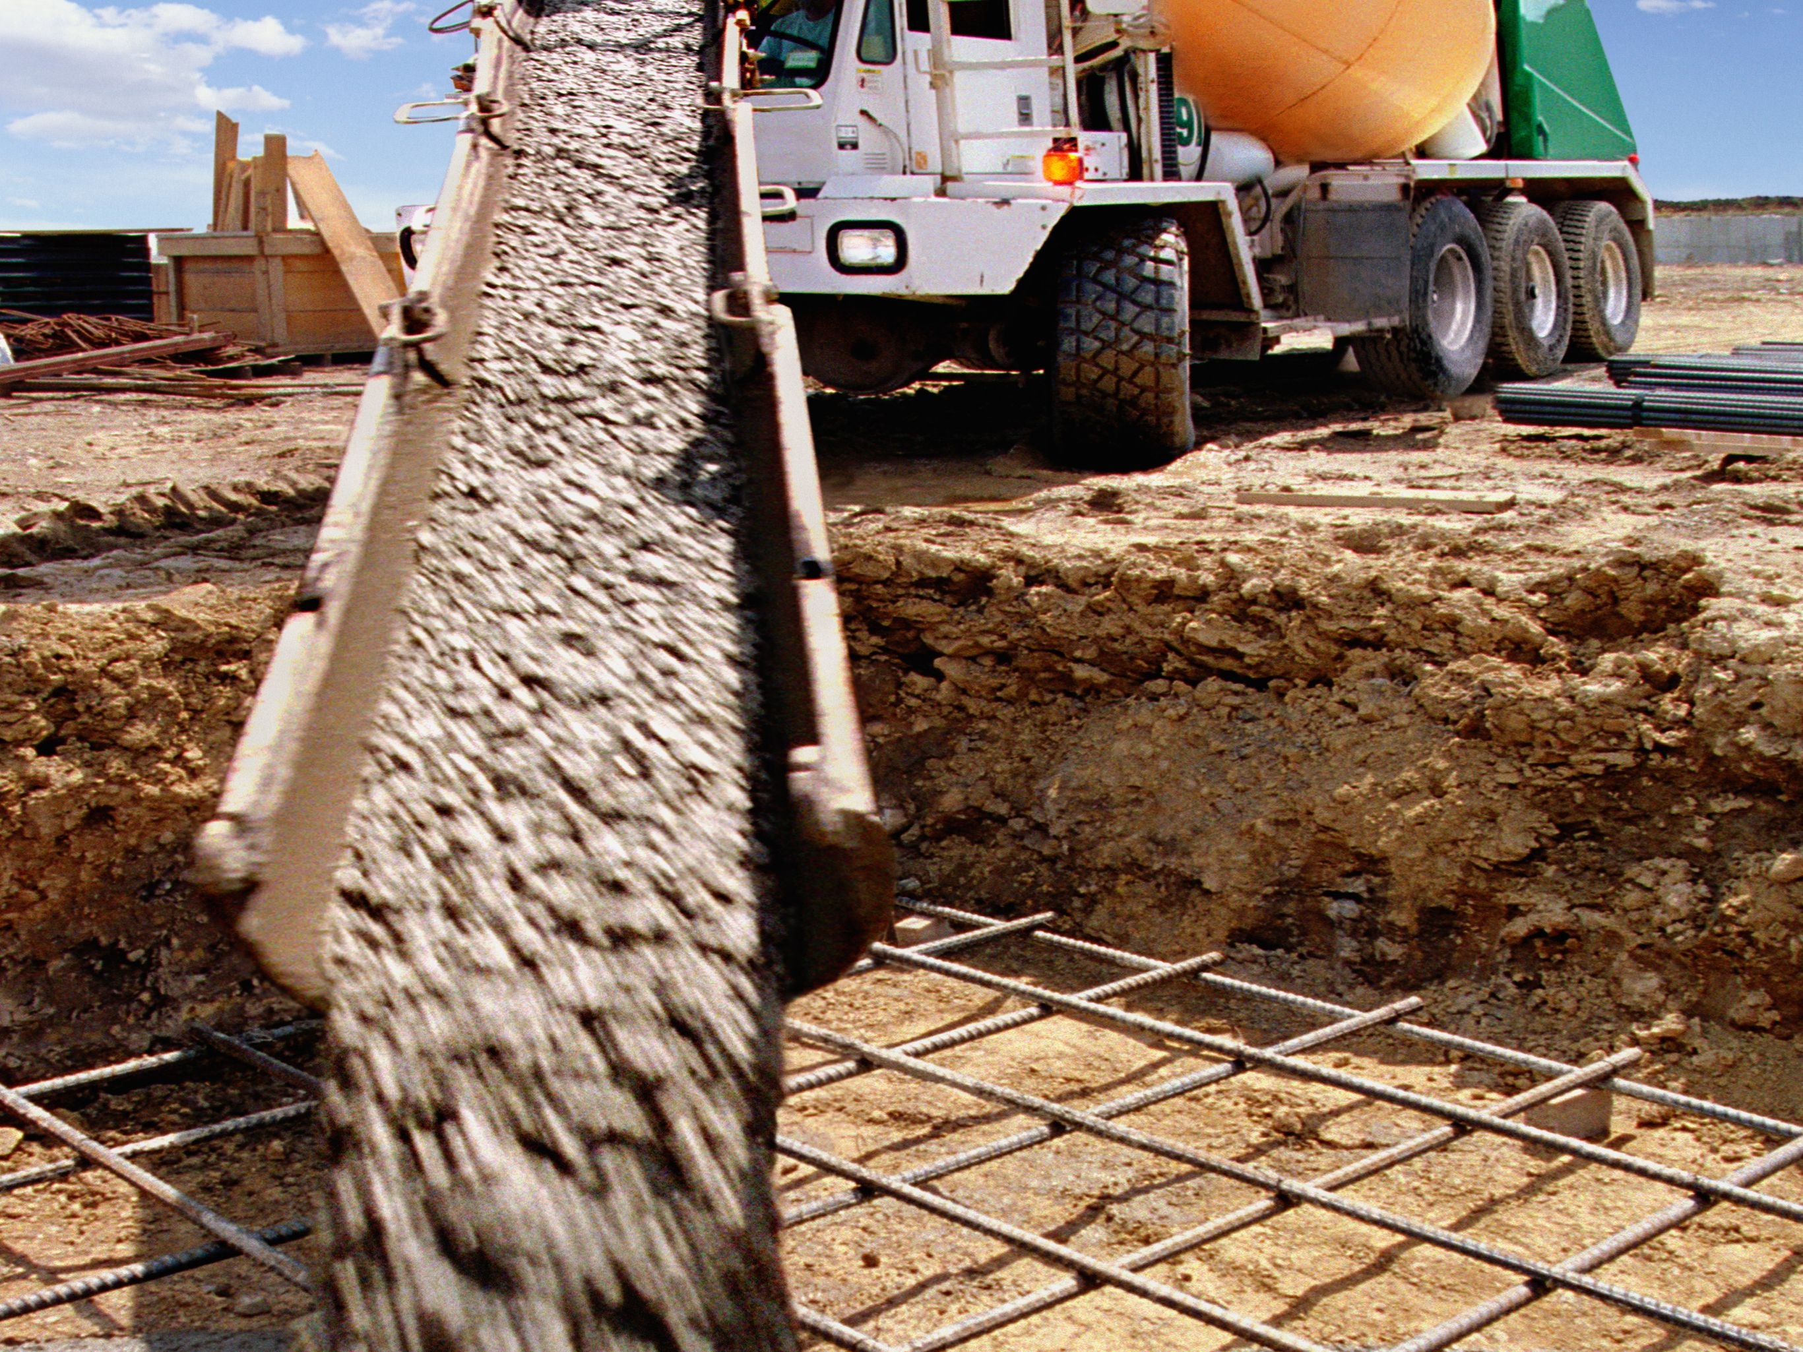





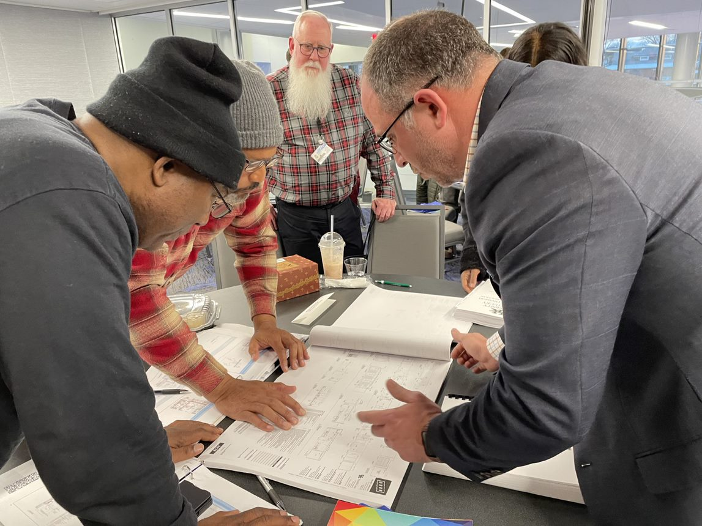
Engage in the Process –
How to Prepare for Opportunities
Certification—SBA, WBEC ORV, TSMSDC, Veteran, State, Healthcare Contractor certifications etc.
Capabilities Statement
Email, website, LinkedIn
marketing collateral
Registered with Lynn Imaging as a supplier
And registered in the UK Plan Room
Check UK Bids and Opportunities
Understand how to submit bids and requests for proposals
Proper level of liability Insurance
Bonding
Prequalified with
Construction Managers and General Construction Companies
A client with KY Apex SBA, KSBDC, Commerce Lexington or other entities for small business coaching
How to do Business with the University of Kentucky | February 28, 2024
Notes:
So how do you prepare to work with the University of Kentucky. Some of these tips are specific to construction, but most are for all businesses.
Certification is important because it connects you to a community of like-minded businesses, resources. You will learn everything you need to know about certification in Workshop #4.
Think of your Capabilities Statements as your business resume or calling card. Make sure you have one and keep it current. I use them all the time to showcase your business to our project managers.
Keep all your business data current.
Understand the scope of work and how to bid and submit RFPs. This is a barrier we can help you overcome.
Maintain proper levels of liability insurance and workman’s comp.
Bonding is not just for construction projects. Bonding is also another barrier for small businesses. We will address Bonding in Workshop #3. Don’t miss it.
Many construction companies have a pre-qualification process. Meet with companies and find out what they are looking for when there are no bids on the line. That’s the best way to build relationships. Business is about relationships.
Work with our business resource partners. They are here to help. You will learn more about the services of our business resource partners in Workshop #2.

Slide 5

GROWING OUR OWN
Growing Sustainable Small Businesses in Kentucky
How to do Business with UK
Understanding Your Small Business Resources
Understanding Bids, RFP and Insurance
Which certification is
Right for Your Business
https://edc.uky.edu/growing-our-own-workshop-series

Slide 6
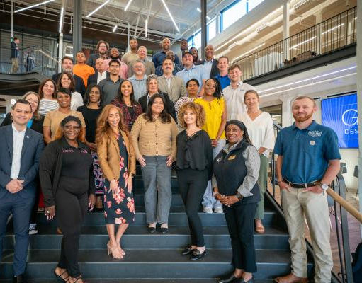
Turner-UK Construction
Business accelerator 2026
The 12-week curriculum covers important topics like safety, site logistics, insurance and bonding, contracts, subcontracting, construction drawings and specifications, estimating, scheduling, bid and proposal preparation, construction accounting, certification, and more.
Team project focused on a post bid review
Notes:
The Construction Diversity Accelerator is an example of the kind of support we give through our training programs. This is a 12-week program. We prepare contractors to do business with UK and other partners
We will begin cohort #4 in March. We have graduated over 48 businesses since 2022.
CDA graduates are winning contracts with UK and other partners.
Applications are now open for Cohort #4. Scan the QR code and it will take you to the application.
Applications close on January 24, 2025. If you are interested, apply early!

Slide 7

Kentucky Education Procurement Association 2025
Kentucky Education Procurement Association - 2025
Bridging Innovation & Tradition
September 21- September 23, 2025
Nothern Kentucky University
$125 per attendee
Vendors invited to attend on September 22nd
https://kentuckyedprocurement.com/
Hotel: Hampton Inn Suites by Hilton10
Hampton Lane, Wilder, KY 41076
Phone: 859-441-3049
Room Block End: August 29, 2025

Slide 8
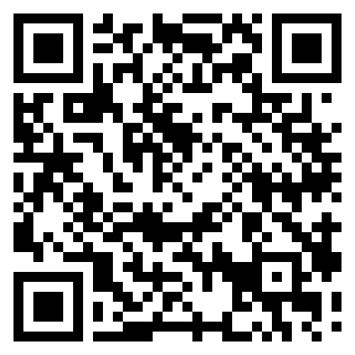
Contact Us
UK Procurement Services
322 Peterson Service Building
411 South Limestone
Lexington, KY 40506
859-257-9100
https://purchasing.uky.edu/
https://www.lynnimaging.com/
Naomi Emmons
Deputy Chief Procurement Officer
Naomi.Emmons@uky.edu
Corey W. Leslie
Associate Director
Construction Procurement
Corey.Leslie@uky.edu
Ken Scott
Kenneth.Scott@uky.edu
Marilyn Clark
Economic Engagement Manager
Marilyn.Clark@uky.edu
https://purchasing.uky.edu/economic-engagement
Notes:
Here is the contact information.
Scan the QR code for the Economic Inclusion website. You will find information on bids, business resources and news about what we are doing.

Slide 9
What is “MRO”?
MRO stands for Maintenance, Repair, and Operations. It encompasses the indirect materials and services needed to keep a facility or equipment running, even though they are not directly involved in the production of goods. This includes everything from spare parts and safety equipment to cleaning supplies and tools.
Effective MRO management is crucial for preventing downtime, ensuring safety, and controlling costs.

Slide 10
AUTHORIZATION OF WORK
For each individual project under this contract, a separate order will be issued. The process for project authorization will be as follows:
NOTE: No work shall be started and/or completed without an authorized purchase order having been issued and received by the contractor. Should the Contractor start and/or complete a project without an authorized purchase order the contractor is taking the risk of not being paid for such work.
The Owner will identify projects and provide the scope of work to the Contractor either with drawings, specifications, and/or a site visit (on smaller projects, a site visit may be all that is required), if any bonds are needed, it will be clarified at this stage. The contractor shall have a representative meet to review project within 2 working days. Emergency projects will need an immediate response.
Within the 2 working day timeframe for each identified project the Contractor shall present a written, fully itemized quote to the Owner.

Slide 11
AUTHORIZATION OF WORK (Cont’d)
Individual projects under this contract will be limited in scope to under $250,000 with the following parameters:
All projects under $250,000 will be assigned by the Project Manager as required.
For Projects estimated $100,000 - $250,000: The Owner will request a quote from an awarded contractor. Quotes provided should be itemized (IE; labor, materials, etc.). If the Owner is satisfied with the quote an award shall be made. The Owner may request a quote from one or more contractors to determine “Best Value”.
Note* Projects over $100,000 will require Payment and Performance Bonds. The contractor should be alerted of this need at the time the quote is being requested.
All projects estimated above $250,000 will either be competitively bid in accordance with Kentucky Revised Statutes Chapter 45A (KRS 45A) or be performed under The University’s Job Order Contracting (JOC) requirements.
The University may use multiple trade contractors to complete an individual project. Coordination among trades may be required as long as the project does not exceed $250,000 (Self-Performance Cap).

Slide 12
Key Event Dates
Written Questions Due – 08/15/2025
Final Addendum Out – 08/28/2025 *On or about
Proposals Due – 09/05/2025 @ 3:00 P.M. in Room# 322 – Peterson Service Building, 411 South Limestone, Lexington, KY 40506.
All proposals must be submitted directly to UK Procurement. No electronic proposals will be accepted.
Proposals can be mailed using USPS, UPS, FEDEX, etc.,
but they must be received no later than 3:00 P.M. on the due date.
All questions must be submitted in writing to Ken Scott at cckbidquestions@uky.edu. Please use the proposal number
and title in the ‘Subject’ line of your email and submit your questions in Excel format as per this example:
*** note this is an RFP, not a bid, so there are no public readings ***

Slide 13
SCOPE
This Request for Proposals (RFP) is for the University of Kentucky to establish Price Contracts for the furnishing of all labor including supervision, materials, supplies, tools, appliances, equipment, permits, inspections, bonds (if deemed necessary), and any additional services necessary for maintenance and repairs for The University of Kentucky and its affiliates. The Successful Contractors should be capable of providing qualified (licensed) and skilled tradesmen as required.

Slide 14
SCOPE (Cont’d)
It is the intent of The University to establish Price Contracts with multiple responsible contractors per trade based on the responses to this RFP. Decisions based on the Criteria defined in Section 4.0 Proposal Format and Content and the Performance Metrics as described in Attachment A, and financial proposals.
At minimum, potential Contractors should meet the following:
The offeror maintains a permanent place of business.
Has adequate equipment to perform work properly and expeditiously.
Suitable financial statue to meet obligations incidental to the work.
Has appropriate technical experience and competent personnel.
Is properly licensed and insured.
Has reputable references attesting to the firm’s qualifications and capabilities on trades proposed.

Slide 15
SCOPE (Cont’d)
The University has immediate needs for the following trades: BUT NOT LIMITED TO!!!!!
- Mechanical/HVAC
- Electrical, including High Voltage
- Plumbing
- Fire Suppression
- Carpentry
- Door Replacement Specialists
- Painting & Patch
- Drywall & Repair
- Concrete installation and Repair
- Asphalt, Blacktop repair and Striping
- Flooring
- Boiler Repair and Maintenance (preventative maintenance programs can be included)
- Chiller Repair & Maintenance (preventative maintenance programs can be included)
- Controls (panel construction & installation, controller installation, power, conduit & wiring)
- Roofing
- Drain Cleaning
- Glazing
- Acoustical Ceilings
*All other trades are encouraged to participate and will be considered for award based on current demand

Slide 16
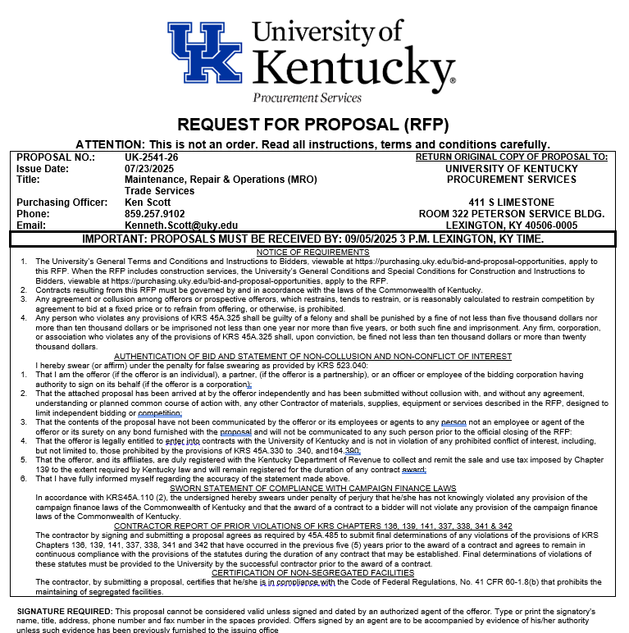
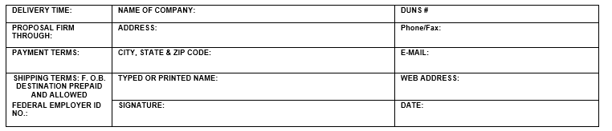
The Offeror will sign and return the proposal cover sheet and print or type their name, firm, address, telephone number and date. The person signing the offer should initial erasures or other changes. An offer signed by an agent is to be accompanied by evidence of their authority unless such evidence has been previously furnished to the purchasing agency. The signer shall further certify that the proposal is made without collusion with any other person, persons, company or parties submitting a proposal; that it is in all respects fair and in good faith without collusion or fraud; and that the signer is authorized to bind the principal offeror.

Slide 17
Proposal Information and Criteria (Section 4.1) & Misc. Items
Please read the entire proposal.
Make sure to read and review all attachments and addenda.
Please review the insurance requirements as stated in Section 6.19 to ensure you have the required coverage.
The following list specifies the items to be addressed in the proposal. Offerors should read it carefully and address it completely and in the order listed to facilitate the University’s review of the proposal.
Proposals should be organized into the sections identified below. The content of each section is detailed in the following pages. It is strongly suggested that offerors use the same numbers for the following content that are used in the RFP.
• Signed Authentication of Proposal and Statement of Non-Collusion and Non-Conflict of Interest Form
• Transmittal Letter
• Attachment E – Performance Metrics
• Executive Summary and Proposal Overview
• Criteria 1 - Offeror Qualifications
• Criteria 2 - Services Defined
• Criteria 3 - Financial Proposal
• Criteria 4 - Evidence of Successful Performance and Implementation Schedule
• Criteria 5 - Other Additional Information

Slide 18
Proposal Submission & Deadline
Offeror must provide the following materials prior to 3 p.m. (Lexington, KY time) on the date specified in Section 3.1 and addressed to the purchasing officer listed in Section 3.2:
Technical Proposal: One (1) copy on electronic storage devices (USB) clearly marked with the proposal number and name, firm name and what is included (Technical Proposal) and one (1) printed original copy.
Financial Proposal: One (1) copy on electronic storage devices (USB) clearly marked with the proposal number and name, firm name and what is included (Financial Proposal) and one (1) printed original copy.
Note: Proposals received after the closing date and time will not be considered. In addition, proposals received via fax or e-mail are not acceptable.
The University of Kentucky accepts deliveries of RFPs Monday through Friday from 8 a.m. to 5 p.m. Lexington, KY time. However, RFPs must be received by 3 p.m. Lexington, KY time on the date specified on the RFP to be considered.

Slide 19
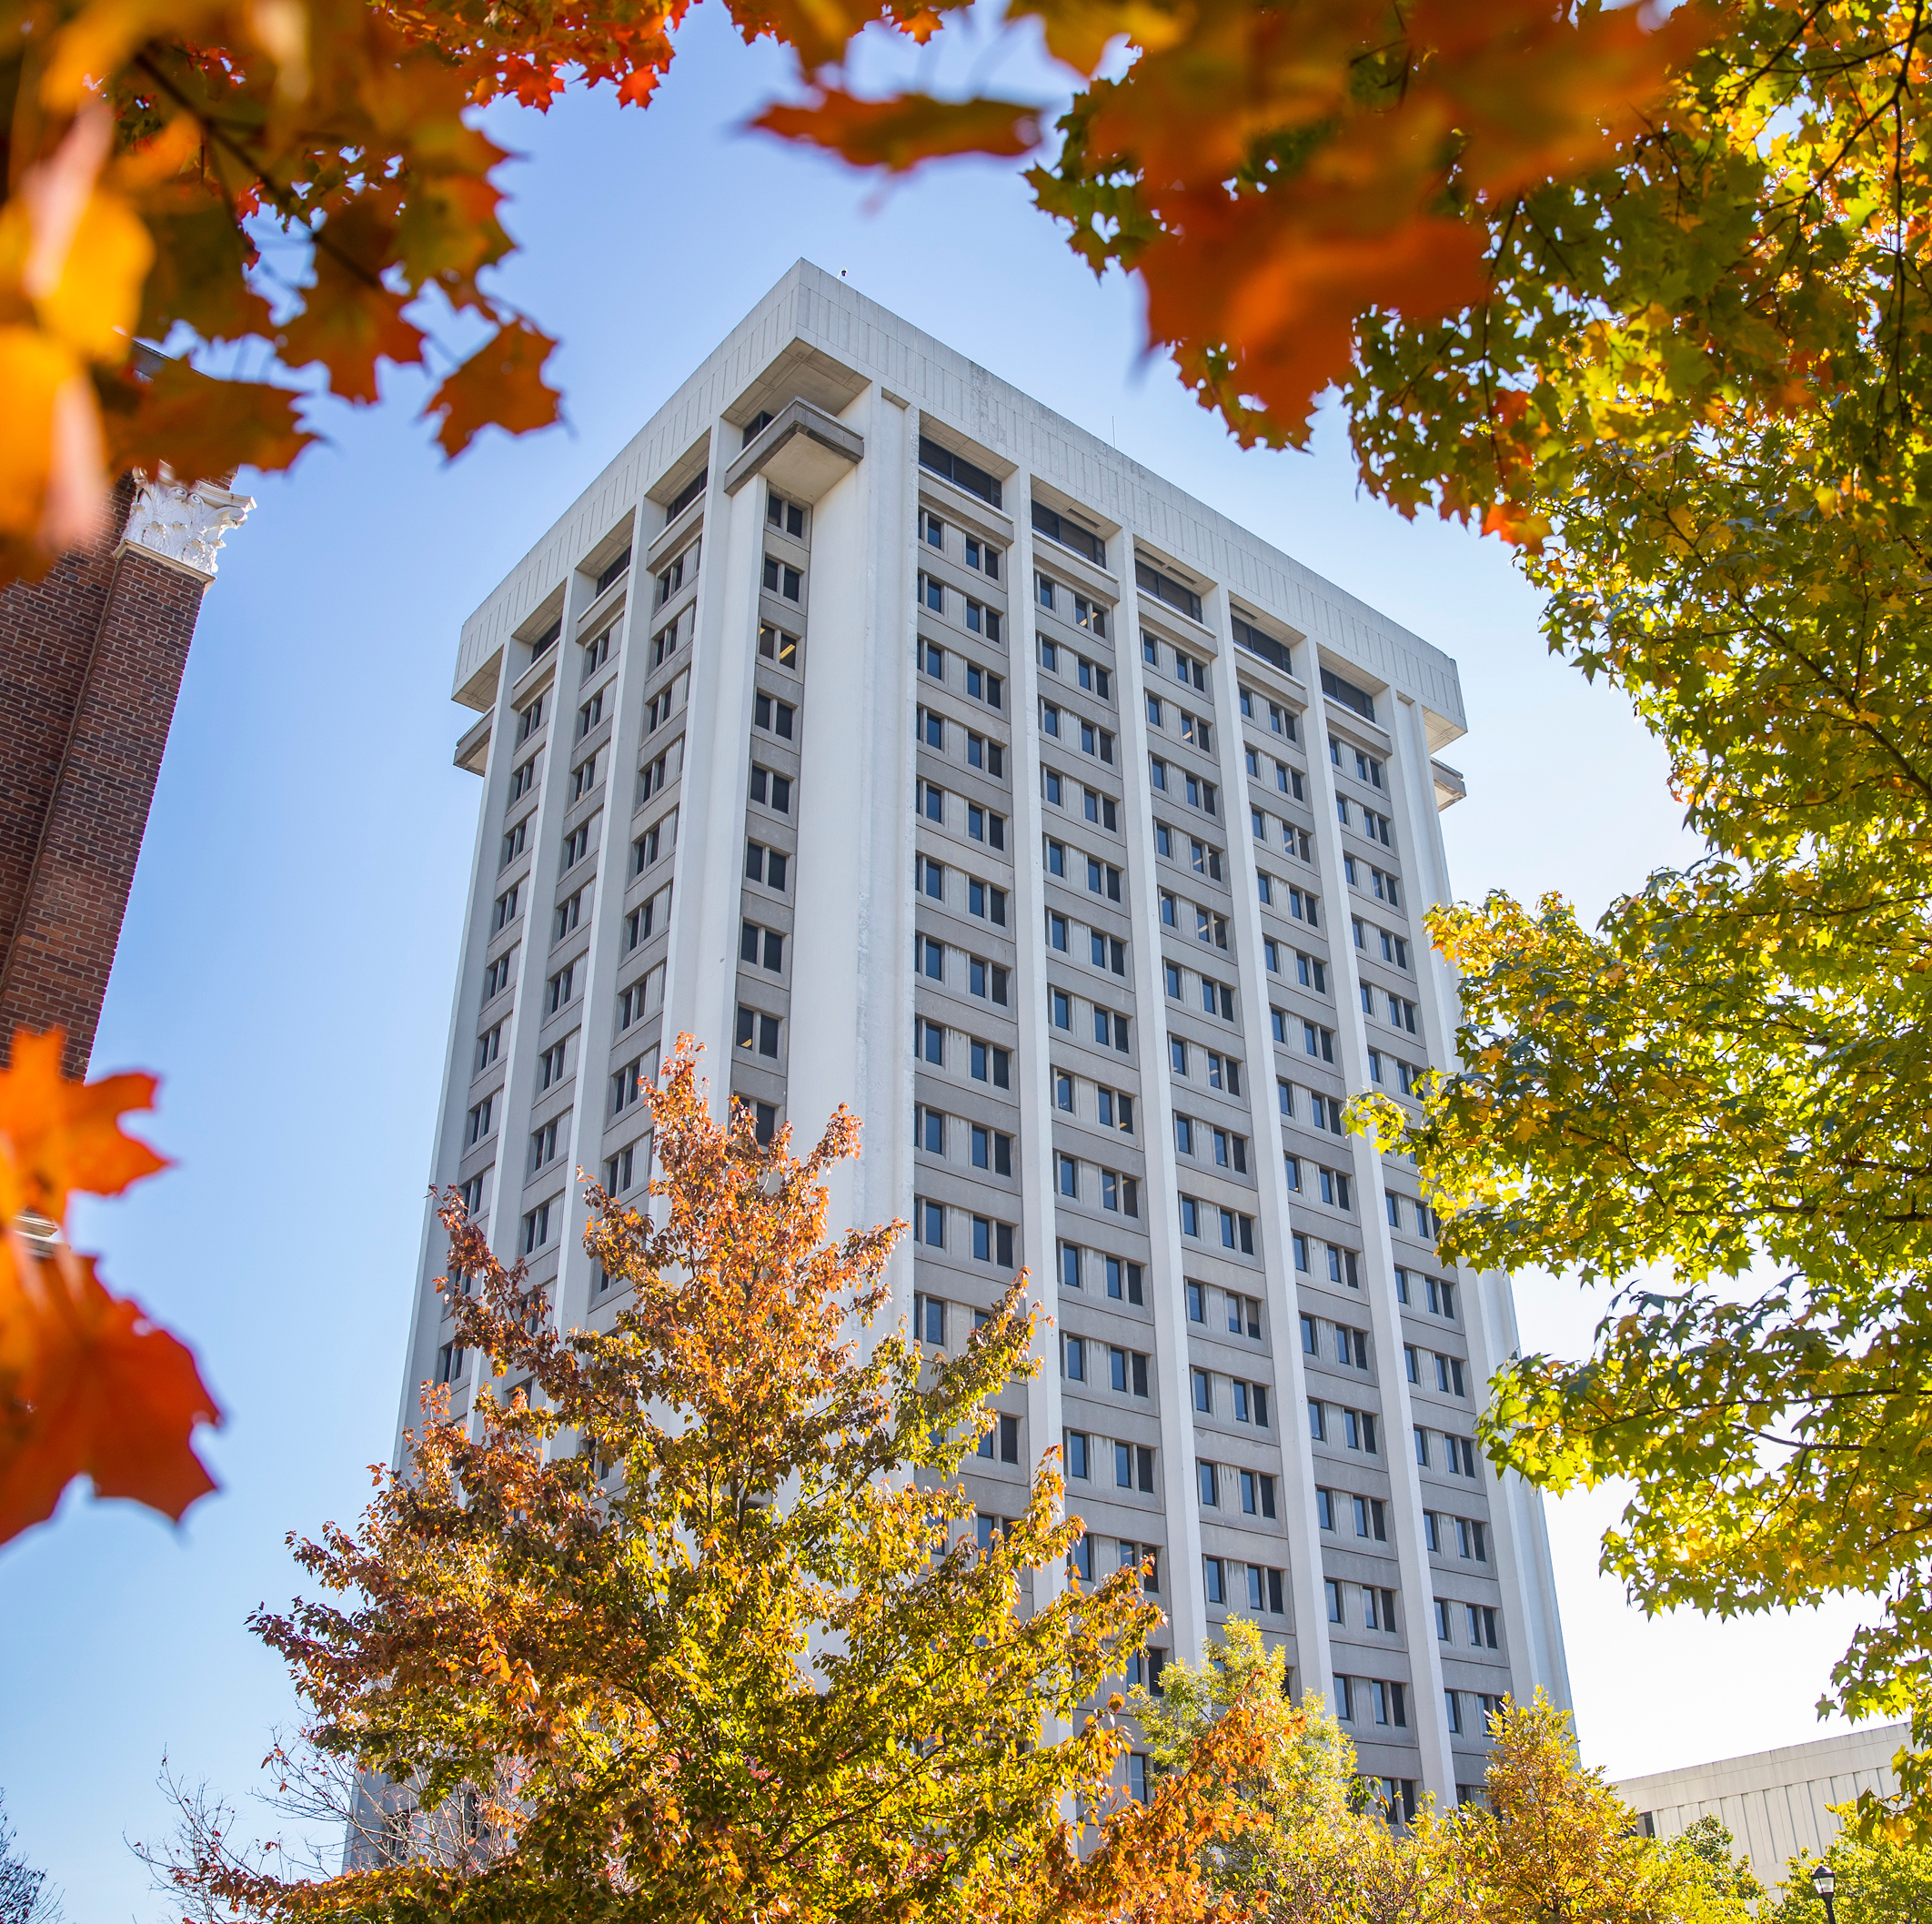
QUESTIONS??

